Slide 1
Team suntory strong @ openhack19
Red cross situational dashboard
2019-11-03
Suntory Strong
David Lindahl
Olof Spångö
Michael Thompson

Slide 2
Current situation
6
Officers on Duty
No
tool support

Slide 3
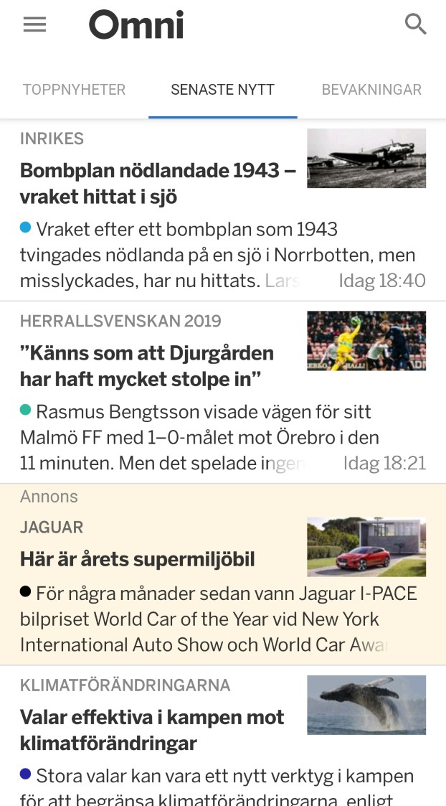
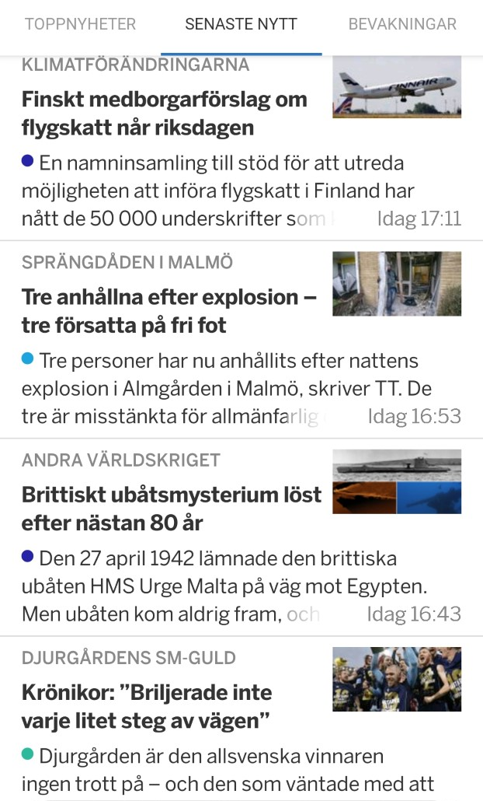
Current situation
6
Officers on Duty
No
tool support

Slide 4
We have developed a tool for the officers on duty to quickly be able to get an understanding of the current situation in Sweden
Purpose
Simplify the work for the officers on duty to quickly identify any relevant events for Röda Korset Sverige, where they might need to act and initiate a crisis operation.
Features
Gathers information from multiple sources, filter the data and present information and events that may be relevant for Röda Korset Sverige in their crisis readiness.
Data Sources
Social media, News sites, disturbances on the electricity and water-infrastructure, police events, crisis-information (krisinformation.se) events, and more...

Slide 5
We have developed a tool for the officers on duty to quickly be able to get an understanding of the current situation in Sweden
Purpose
Simplify the work for the officers on duty to quickly identify any relevant events for Röda Korset Sverige, where they might need to act and initiate a crisis operation.
Features
Gathers information from multiple sources, filter the data and present information and events that may be relevant for Röda Korset Sverige in their crisis readiness.
Data Sources
Social media, News sites, disturbances on the electricity and water-infrastructure, police events, crisis-information (krisinformation.se) events, and more...

Slide 6
We have developed a tool for the officers on duty to quickly be able to get an understanding of the current situation in Sweden
Purpose
Simplify the work for the officers on duty to quickly identify any relevant events for Röda Korset Sverige, where they might need to act and initiate a crisis operation.
Features
Gathers information from multiple sources, filter the data and present information and events that may be relevant for Röda Korset Sverige in their crisis readiness.
Data Sources
Social media, News sites, disturbances on the electricity and water-infrastructure, police events, crisis-information (krisinformation.se) events, and more...

Slide 7
Demo of our app
Röda Korsets Lägesanalysverktyg
http://0.0.0.0:5002

Slide 8




Röda Korsets Lägesanalysverktyg
Sammanfattning
Pågående Insatser
! Trafikolycka, stor, Falun
o Risk för storm, södra Sverige
Bussolycka, Falun | 17 volontärer inkallade
o Inga kända större driftstörningar
Kartvy
Risknivå
#
Akut 2
Filter
Hög 4
Medel 10
Plats
Låg 449
Källa
Risknivå
Tidpunkt
Flöde

Slide 9
Mocked up design of Future App

Slide 10
Future features will include information from additional sources, and an improved information filtering functionality
Improved information filtering functionality
Intelligent ranking/severity-rating functionality using ML models
Ability to manually filter on
Additional data sources
Disruption information from the main electricity grid and water infrastructure operators
Local news information (web-scrape local websites if no API available)
Twitter and other social media
Communicate to volunteers directly from the Dashboard
Ability to push SMS and emails to volunteers in vicinity of event
Notifications feature
Push notifications to officers on duty when high or acute events are discovered
Overview of ongoing operations
Information of how many volunteers are currently activated, on hold, ...
Location, severity and trend (worsening or improving)
Latest situational reports

Slide 11
THANK YOU!

Slide 12
Appendix: Technical Architecture

Slide 13
Links to API’s etc.
http://api.krisinformation.se/ - /v1/capmessage (denna verkar inte uppdateras så frekvent)
https://polisen.se/api/events - Polisens API med händelser

Slide 14
Röda Korset Lägesanalysverktyg
Sammanfattning
Pågående Insatser
! Trafikolycka, stor, Falun
Bussolycka, Falun | 17 volontärer inkallade
o Risk för storm, södra Sverige
o Inga kända större driftstörningar
Flöde
Filter
Plats
Källa
”Severity”
Tidpunkt
Kartvy
Akut 2
Hög 4
Medel 10
Låg 449

Slide 15
Röda Korset Lägesanalysverktyg
Sammanfattning
Pågående Insatser
! Trafikolycka, stor, Falun
Bussolycka, Falun | 17 volontärer inkallade
o Risk för storm, södra Sverige
o Inga kända större driftstörningar
Kartvy
Akut 2
Hög 4
Filter
Medel 10
Plats
Låg 449
Källa
”Severity”
Tidpunkt
Flöde

Slide 16
Röda Korset Lägesanalysverktyg
Sammanfattning
Pågående Insatser
! Trafikolycka, stor, Falun
Bussolycka, Falun | 17 volontärer inkallade
o Risk för storm, södra Sverige
o Inga kända större driftstörningar
Kartvy
Risknivå
#
Akut 2
Filter
Hög 4
Plats
Medel 10
Källa
Låg 449
Tidpunkt
Risknivå
Flöde

Slide 17
We have developed a tool for the officers on duty to quickly be able to get an understanding of the current situation in Sweden
Purpose
Make it easier for the officers on duty to quickly identify any relevant events for Röda Korset Sverige where they might need to act and initiate a crisis operation.
Features
Gathers information from multiple sources, filter the data and present information and events that may be relevant for Röda Korset Sverige in their crisis readiness.
Data Sources
Social media, News sites, disturbances on the electricity and water-infrastructure, police events, crisis-information (krisinformation.se) events, and more...

